Slide 1
Hostel Room Reservation System Tribhuvan University, Kritipur
presented by : under supervision Of :
Avishek Khatiwada raaju poudel
Yubraj Adhikari mechi multiple campus Bhadrapur , jhapa , nepal

Slide 2
Contents:
Abstract
Introduction
Objective
Scope
Features
Context Diagram
DFD
ER-Diagram
Limitations
Future Enhancement
Conclusion

Slide 3
Abstract
Online Hostel Room Reservation System’ is a online web application targeted for the College Hostel which is used by students to book the room in the Hostel . . This System provides a detailed view of how students records, room allocation and courses. The admin is provided with better control over the transactions like adding details of new students in the hostel, modifying the details of the students, deleting the students, viewing the students details in the Hostel. This system deals with the problem on managing a Hostel and avoids the problems which occurs when carried out manually such as duplicate entries. Thus this system will helps College in better utilization of resources. The main objective of this system is to provide a facility to user to book room in hostel and view notice provided. System is able to see the check-in and check-out of the students.

Slide 4
Introduction
In context there are many Hostel accommodation available for college student to live. But it lacks the digitalization process and we find most of the activities are done manually with physical interaction. As now there are few Hostel System online which mostly are inbuilt with college software which lacks many features. Generally students have to visit the hostel and checks for availability of room that expense both time and money. This motivates our project team to develop a separate web based application that facilitate students to book room in a hostel easily through online.
The project aimed to build a fully functional system in order to achieve the efficiency in the hostel room reservation system. The overall mission of system development is to make online hostel room reservation system easy.

Slide 5
Objective
To allow Students to book room in hostel.
To allow student to view information regarding room’s availability.
Admin can add/update/delete rooms & notice.

Slide 6
Scope
The proposed ‘Hostel Room Reservation System’ project is a computerized system. The use of this project in the hostel can reduce all the problems that exist in manual hostel room reservation system. The main objective of developing ‘Online Hostel Room Reservation System’ is to save time and money of students. The project will be covering following areas :
Modules for registration, login and password recovery.
Platform for Admin to add and remove rooms, course and notice.
Platform for Admin to view students by block-wise.
Platform for students to view details and book rooms.

Slide 7
Features
Status of rooms
Reservation Management
Manage check-in/check-out record
Long term storage of record
Data redundancy can be avoided
Easy to handle, update and keep record
High Security

Slide 8
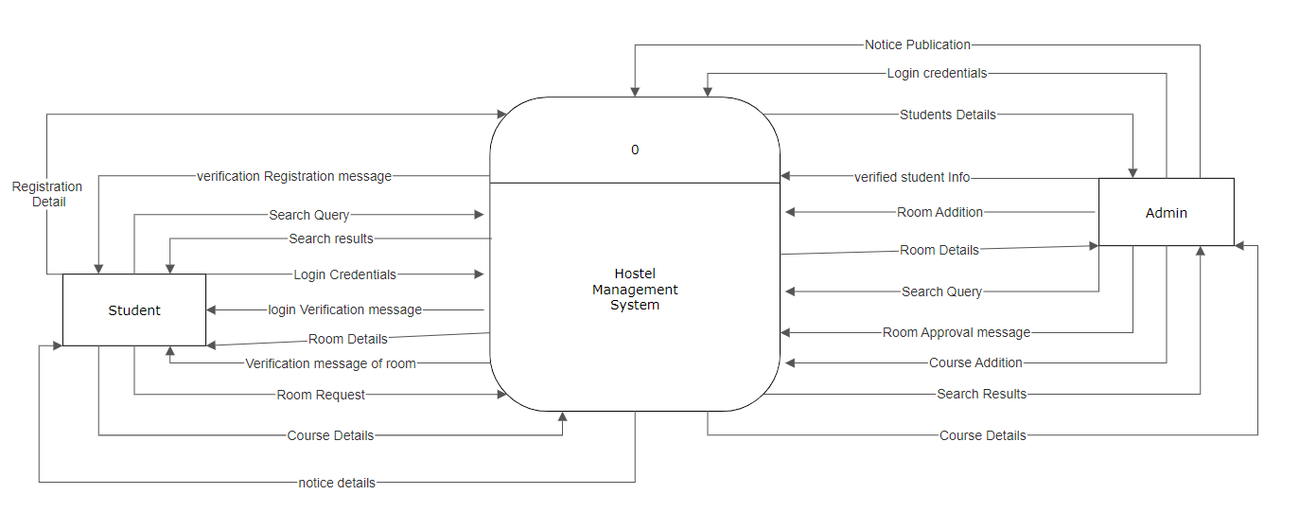
Context Diagram

Slide 9
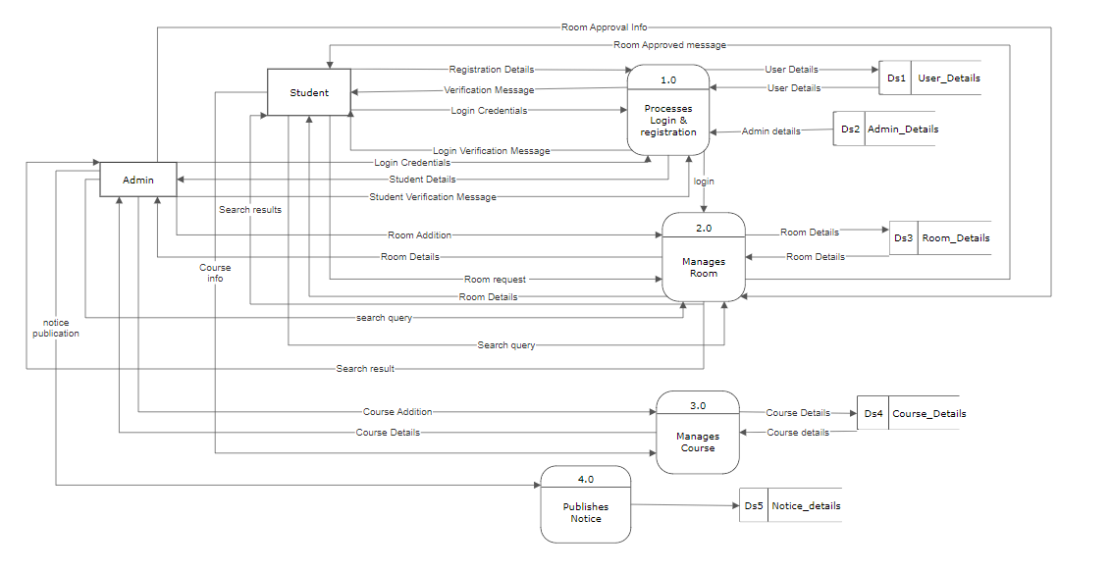
DFD Level-1

Slide 10
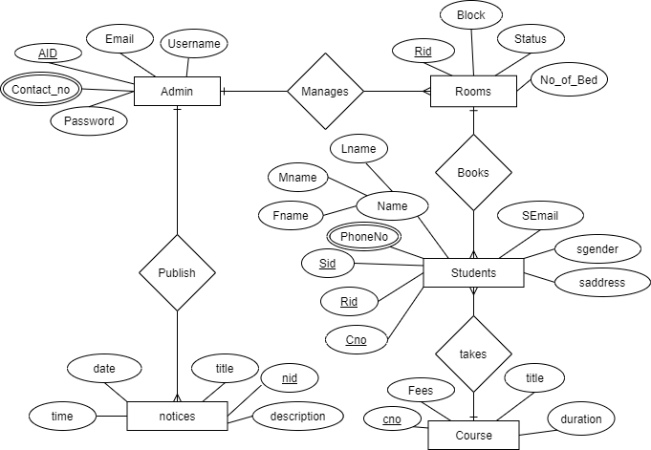
ER Diagram

Slide 11
Limitations
Needs active internet connectivity.
Needs web enabled device.
Payment still needs to be physical.

Slide 12
Future Enhancement
Online Hostel Room Reservation system .This hostel management software is designed for college which owns hostel. This project is small package which includes different categories as well as having all possible features. We have expected that it will be helpful to the, students as well as college. Following are the possible future enhancements:
User interface upgrades
Privilege of adding multiple records at same time.
Improvement in performance.
User can change password.
Online Payments.
Bug fixes.

Slide 13
Conclusion
“Hostel Room Reservation System” is a online web application that allows student to book room in a hostel online. It avoids the problem which occur while booking room in a hostel manually. This project will automate records of student, rooms and courses. After the completion of this project student can check information about room’s availability and book room among it.

Slide 14
THANK YOU

